Slide 1
Women of the Civil Rights Movement
By Precious Barksdale
February 15, 2011

Slide 2
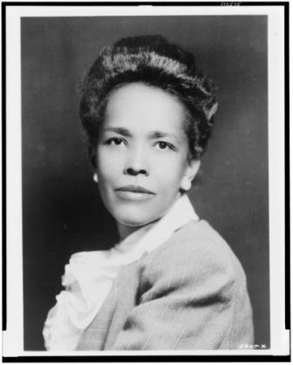
Ella Josephine Baker
Born: December 13, 1903
Died: December 13, 1986
Civil rights
Human rights activist
Civil rights leader
Mississippi Freedom Summer
Student Nonviolent Coordinating Committee (SNCC)
Mississippi Freedom Democratic Party
Democratic National Convention (1964)

Slide 3
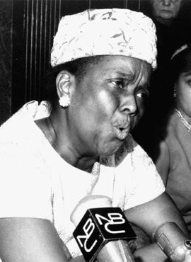
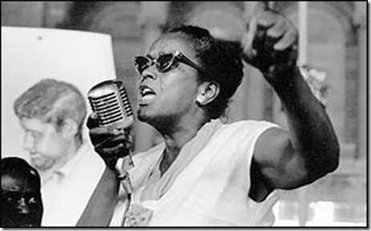
Ella Josephine Baker
http://www.youtube.com/watch?v=73Z87y6OgGc
-3:11 to 3:46

Slide 4
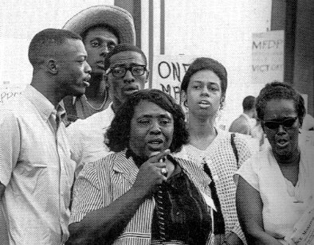
Fannie Lou Townsend Hamer
Born on October 6, 1917 and died on March 14, 1977
Voting rights activist
Civil rights leader
Mississippi Freedom Summer
Student Nonviolent Coordinating Committee (SNCC)
Mississippi Freedom Democratic Party
Democratic National Convention (1964)

Slide 5
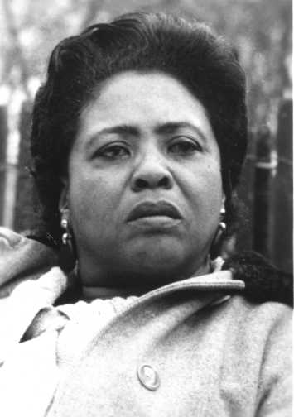
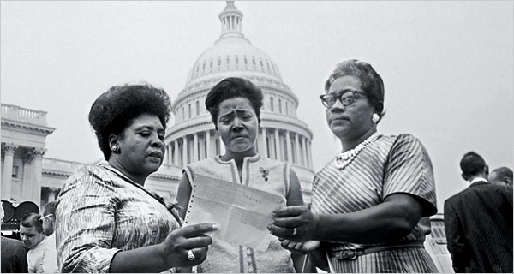
Fannie Lou Townsend Hamer
http://www.youtube.com/watch?v=OC3pQfLOlkQ&feature=related
1:05 to 1:25 (20 seconds)

Slide 6
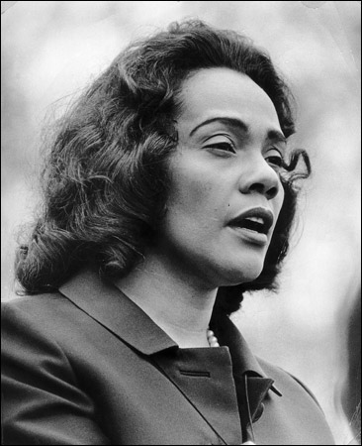
Corretta Scott King
Born on April 27, 1927 and died on January 30, 2006
African American author, activist and civil rights leader
Active member of the NAACP
Participated in the Montgomery Bus Boycotts
She married Dr. Martin Luther King, Jr. in 1953
After King's death she was under close surveillance by the FBI
She was against the South African Apartheid and against homophobia during her later years

Slide 7
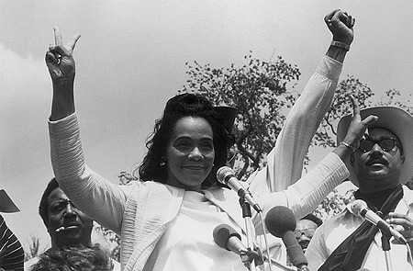
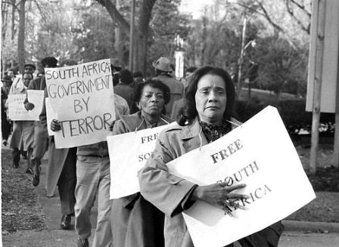
Corretta Scott King
Above Right: 1970 peace demonstration at Washington D.C.
Below Left: Protest for the South African Apartheid in 1986

Slide 8
Bibliography
Mills, Kay (1993). This Little Light of Mine: The Life of Fannie Lou Hamer. New York: Dutton.
S. G. O’Malley, "Baker, Ella Josephine," American National Biography Online (2000).
Osborne, Linda Barrett. Women of the Civil Rights Movement. San Francisco: Pomegranate, 2006. Print.
Gelfand, Dale Evva, and Lisa Renee. Rhodes. Coretta Scott King: Civil Rights Activist. New York: Chelsea House, 2007. Print.
Donovan, Sandra. Fannie Lou Hamer. Chicago: Raintree, 2004. Print.

